Slide 1

Chapter 25 Lists, Stacks, Queues, and Priority Queues

Slide 2
Objectives
To design list with interface and abstract class (§24.2).
To design and implement a dynamic list using an array (§24.3).
To design and implement a dynamic list using a linked structure (§24.4).
To design and implement a stack using an array list (§24.5).
To design and implement a queue using a linked list (§24.6).
To evaluate expressions using stacks (§24.7).

Slide 3
What is a Data Structure?
A data structure is a collection of data organized in some fashion. A data structure not only stores data, but also supports the operations for manipulating data in the structure. For example, an array is a data structure that holds a collection of data in sequential order. You can find the size of the array, store, retrieve, and modify data in the array.
Array is simple and easy to use, but it has two limitations:

Slide 4
Limitations of arrays
Once an array is created, its size cannot be altered.
Array provides inadequate support for inserting, deleting, sorting, and searching operations.

Slide 5
Object-Oriented Data Structure
In object-oriented thinking, a data structure is an object that stores other objects, referred to as data or elements. So some people refer a data structure as a container object or a collection object. To define a data structure is essentially to declare a class. The class for a data structure should use data fields to store data and provide methods to support operations such as insertion and deletion. To create a data structure is therefore to create an instance from the class. You can then apply the methods on the instance to manipulate the data structure such as inserting an element to the data structure or deleting an element from the data structure.

Slide 6
Four Classic Data Structures
Four classic dynamic data structures to be introduced in this chapter are lists, stacks, queues, and binary trees. A list is a collection of data stored sequentially. It supports insertion and deletion anywhere in the list. A stack can be perceived as a special type of the list where insertions and deletions take place only at the one end, referred to as the top of a stack. A queue represents a waiting list, where insertions take place at the back (also referred to as the tail of) of a queue and deletions take place from the front (also referred to as the head of) of a queue. A binary tree is a data structure to support searching, sorting, inserting, and deleting data efficiently.

Slide 7
Lists
A list is a popular data structure to store data in sequential order. For example, a list of students, a list of available rooms, a list of cities, and a list of books, etc. can be stored using lists. The common operations on a list are usually the following:
· Retrieve an element from this list.
· Insert a new element to this list.
· Delete an element from this list.
· Find how many elements are in this list.
· Find if an element is in this list.
· Find if this list is empty.

Slide 8
Two Ways to Implement Lists
There are two ways to implement a list. One is to use an array to store the elements. The array is dynamically created. If the capacity of the array is exceeded, create a new larger array and copy all the elements from the current array to the new array. The other approach is to use a linked structure. A linked structure consists of nodes. Each node is dynamically created to hold an element. All the nodes are linked together to form a list.

Slide 9
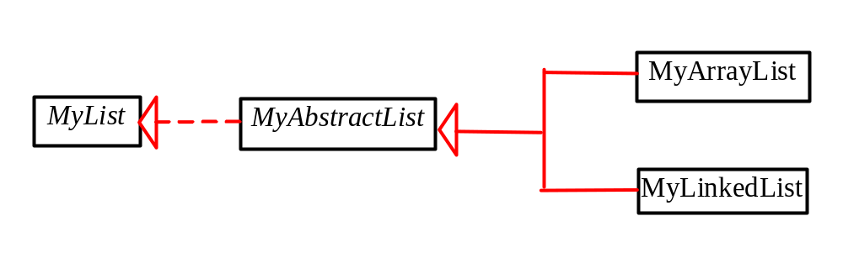
Design of ArrayList and LinkedList
For convenience, let’s name these two classes: MyArrayList and MyLinkedList. These two classes have common operations, but different data fields. The common operations can be generalized in an interface or an abstract class. A good strategy is to combine the virtues of interfaces and abstract classes by providing both interface and abstract class in the design so the user can use either the interface or the abstract class whichever is convenient. Such an abstract class is known as a convenience class.

Slide 10
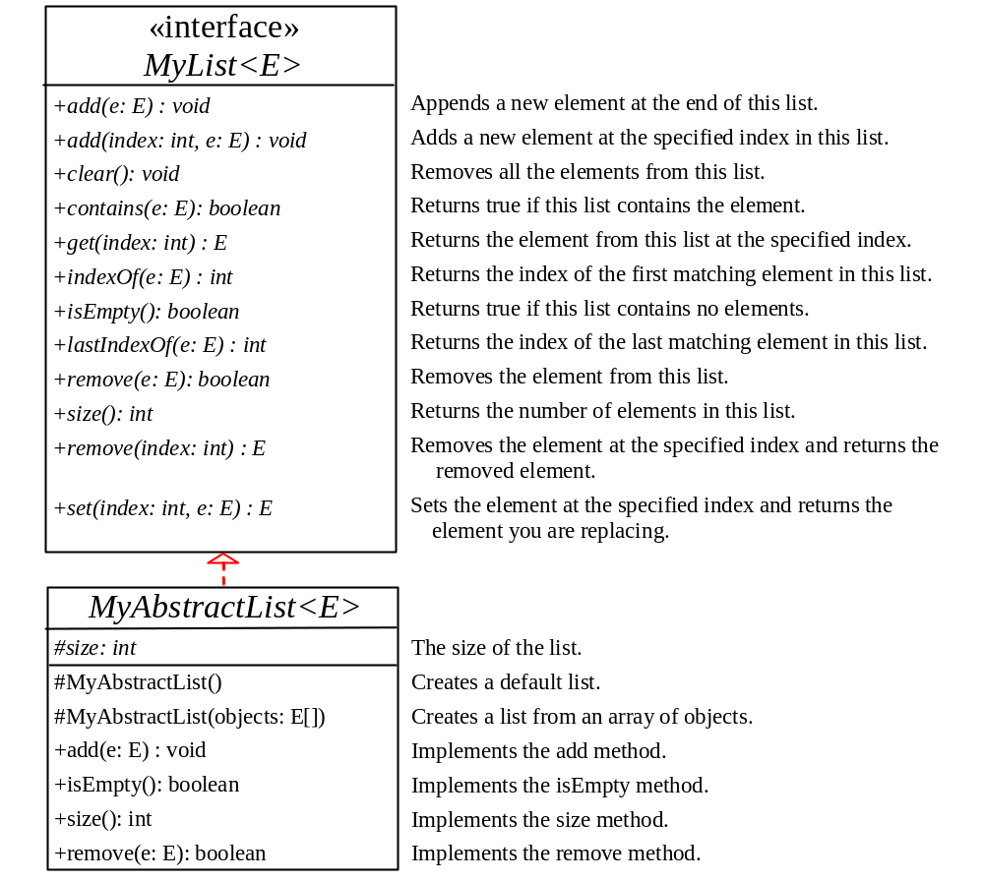
MyList Interface and MyAbstractList Class
MyList
MyAbstractList

Slide 11
Array Lists
Array is a fixed-size data structure. Once an array is created, its size cannot be changed. Nevertheless, you can still use array to implement dynamic data structures. The trick is to create a new larger array to replace the current array if the current array cannot hold new elements in the list.
Initially, an array, say data of Object[] type, is created with a default size. When inserting a new element into the array, first ensure there is enough room in the array. If not, create a new array with the size as twice as the current one. Copy the elements from the current array to the new array. The new array now becomes the current array.

Slide 12
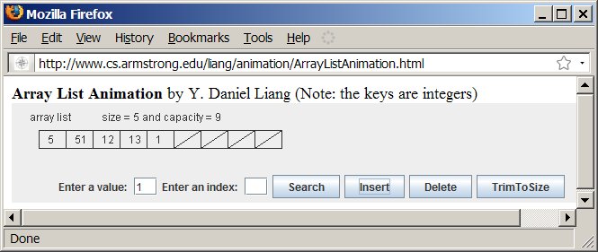
Array List Animation
www.cs.armstrong.edu/liang/animation/ArrayListAnimation.html

Slide 13
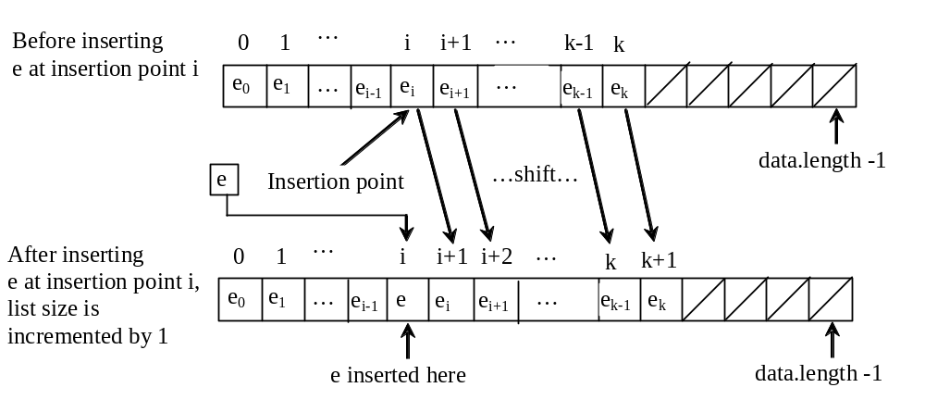
Insertion
Before inserting a new element at a specified index, shift all the elements after the index to the right and increase the list size by 1.

Slide 14
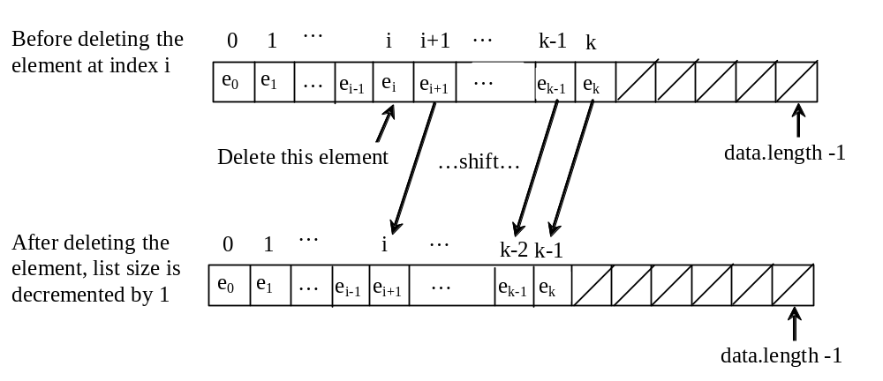
Deletion
To remove an element at a specified index, shift all the elements after the index to the left by one position and decrease the list size by 1.

Slide 15
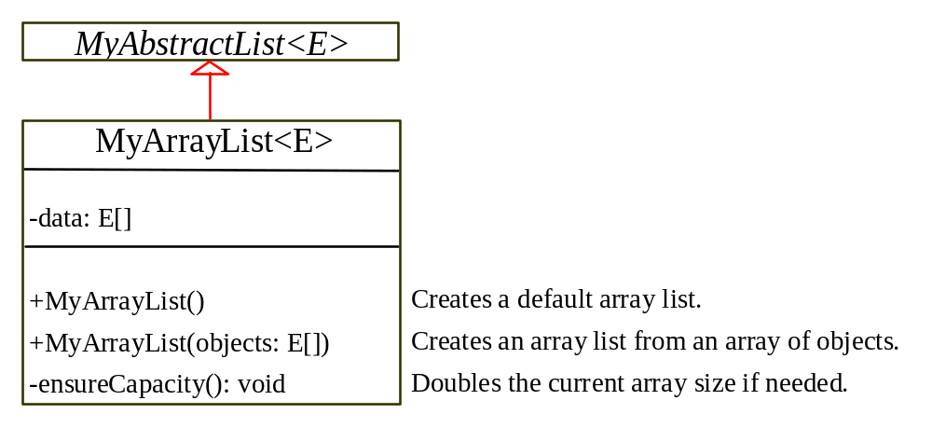
Implementing MyArrayList
MyArrayList
TestList
Run

Slide 16
Linked Lists
Since MyArrayList is implemented using an array, the methods get(int index) and set(int index, Object o) for accessing and modifying an element through an index and the add(Object o) for adding an element at the end of the list are efficient. However, the methods add(int index, Object o) and remove(int index) are inefficient because it requires shifting potentially a large number of elements. You can use a linked structure to implement a list to improve efficiency for adding and removing an element anywhere in a list.

Slide 17
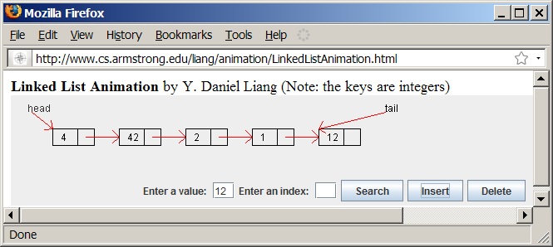
Linked List Animation
www.cs.armstrong.edu/liang/animation/LinkedListAnimation.html

Slide 18
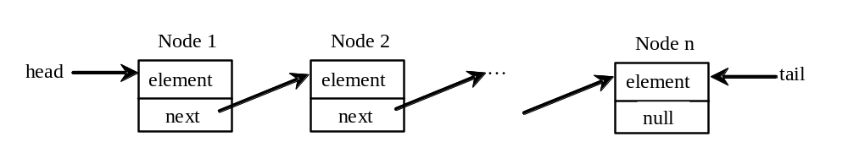
Nodes in Linked Lists
A linked list consists of nodes. Each node contains an element, and each node is linked to its next neighbor. Thus a node can be defined as a class, as follows:
class Node<E> {
E element;
Node next;
public Node(E o) {
element = o;
}
}

Slide 19
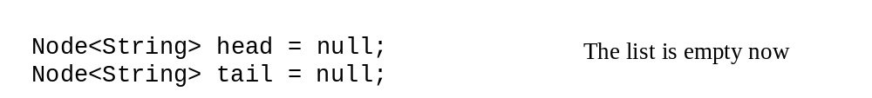
Adding Three Nodes
The variable head refers to the first node in the list, and the variable tail refers to the last node in the list. If the list is empty, both are null. For example, you can create three nodes to store three strings in a list, as follows:
Step 1: Declare head and tail:

Slide 20
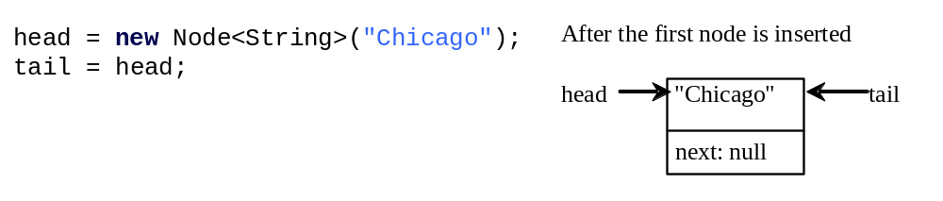
Adding Three Nodes, cont.
Step 2: Create the first node and insert it to the list:

Slide 21
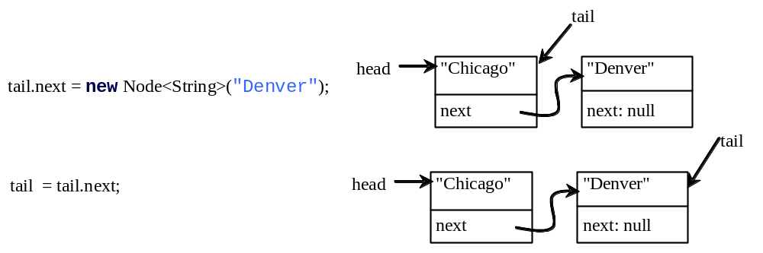
Adding Three Nodes, cont.
Step 3: Create the second node and insert it to the list:

Slide 22
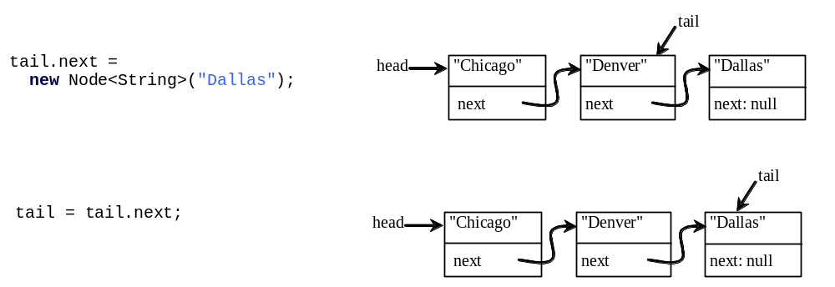
Adding Three Nodes, cont.
Step 4: Create the third node and insert it to the list:

Slide 23
Traversing All Elements in the List
Each node contains the element and a data field named next that points to the next element. If the node is the last in the list, its pointer data field next contains the value null. You can use this property to detect the last node. For example, you may write the following loop to traverse all the nodes in the list.
Node<E> current = head;
while (current != null) {
System.out.println(current.element);
current = current.next;
}

Slide 24
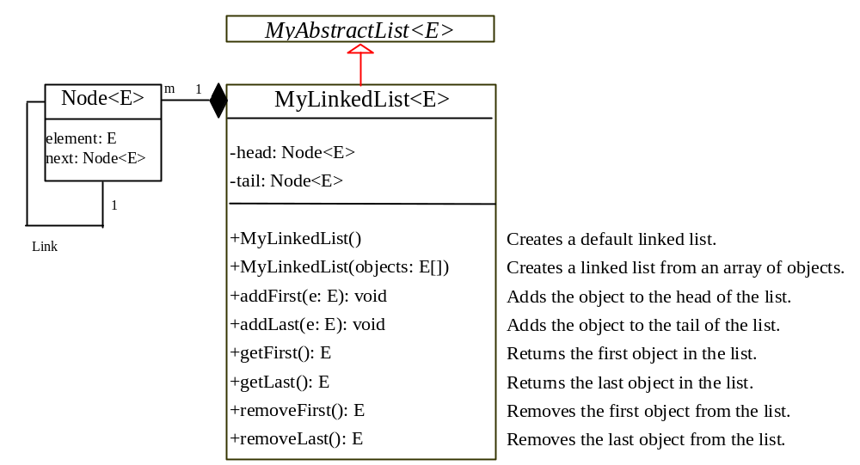
MyLinkedList
MyLinkedList

Slide 25
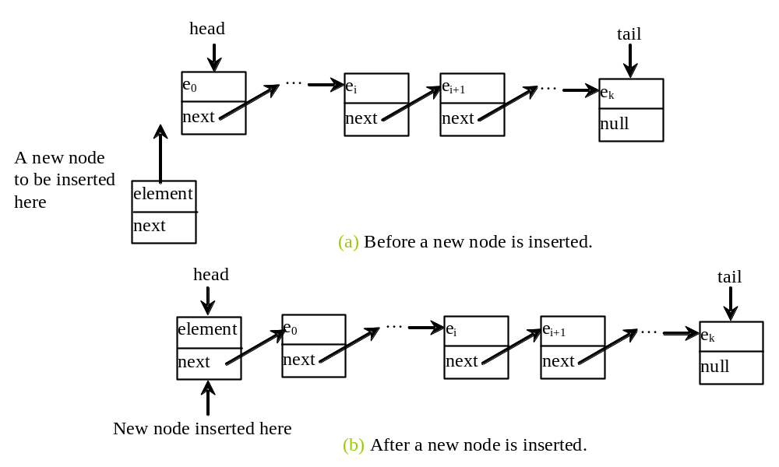
Implementing addFirst(E o)
public void addFirst(E o) {
Node<E> newNode = new Node<E>(o);
newNode.next = head;
head = newNode;
size++;
if (tail == null)
tail = head;
}

Slide 26
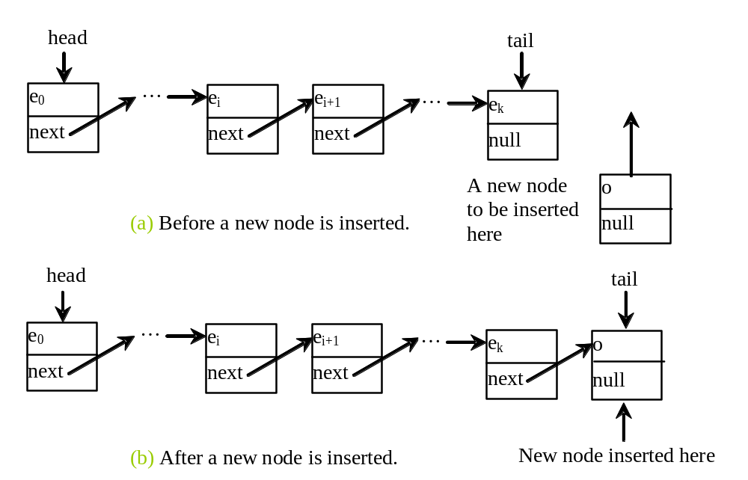
Implementing addLast(E o)
public void addLast(E o) {
if (tail == null) {
head = tail = new Node<E>(element);
}
else {
tail.next = new Node(element);
tail = tail.next;
}
size++;
}

Slide 27
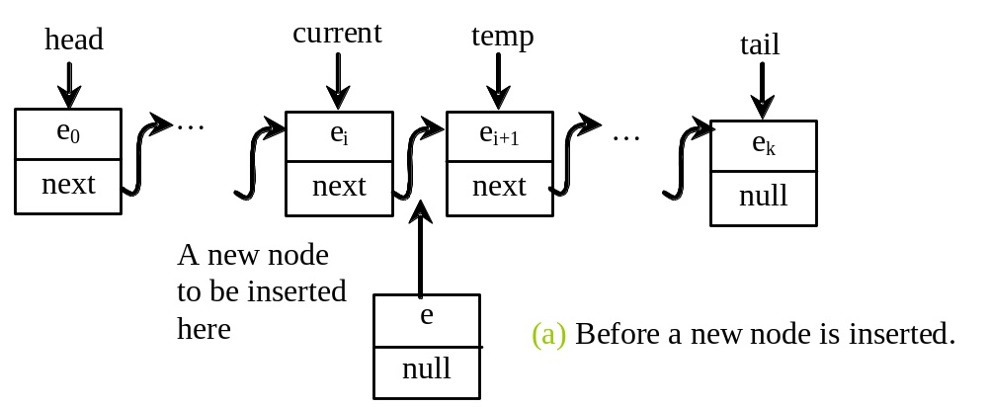
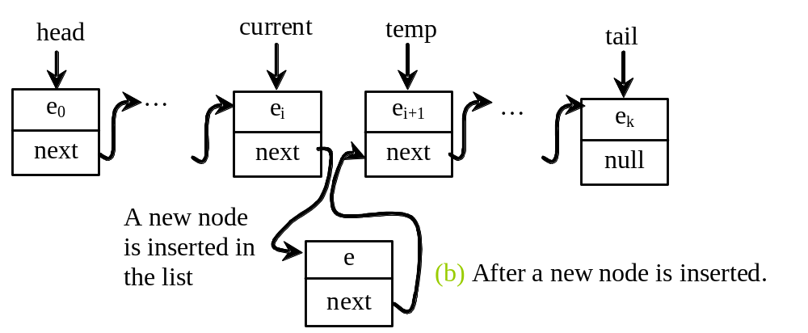
Implementing add(int index, E o)
public void add(int index, E o) {
if (index == 0) addFirst(o);
else if (index >= size) addLast(o);
else {
Node<E> current = head;
for (int i = 1; i < index; i++)
current = current.next;
Node<E> temp = current.next;
current.next = new Node<E>(o);
(current.next).next = temp;
size++;
}
}

Slide 28
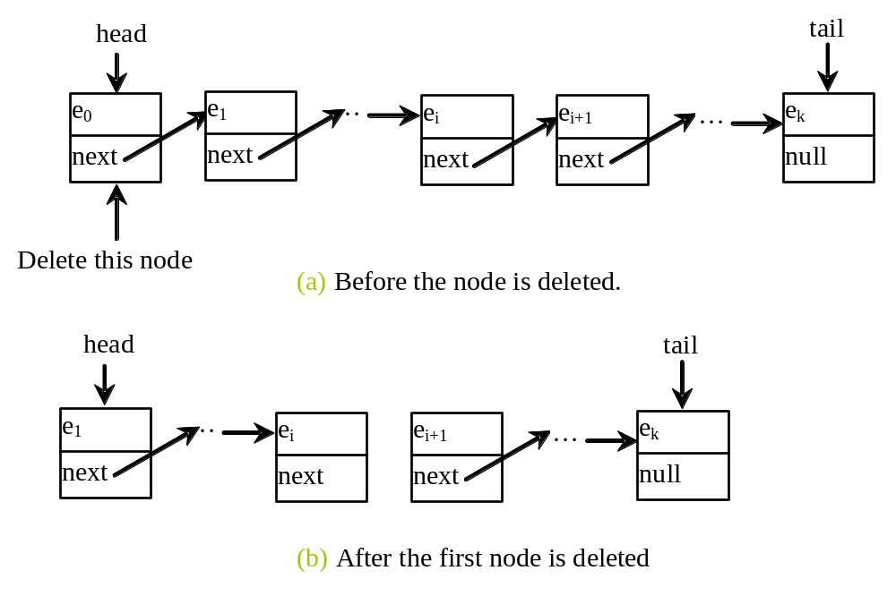
Implementing removeFirst()
public E removeFirst() {
if (size == 0) return null;
else {
Node<E> temp = head;
head = head.next;
size--;
if (head == null) tail = null;
return temp.element;
}
}

Slide 29
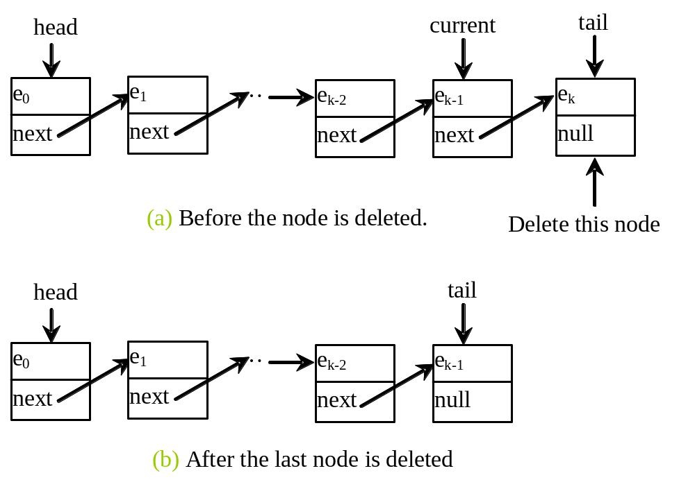
Implementing removeLast()
public E removeLast() {
if (size == 0) return null;
else if (size == 1)
{
Node<E> temp = head;
head = tail = null;
size = 0;
return temp.element;
}
else
{
Node<E> current = head;
for (int i = 0; i < size - 2; i++)
current = current.next;
Node temp = tail;
tail = current;
tail.next = null;
size--;
return temp.element;
}
}

Slide 30
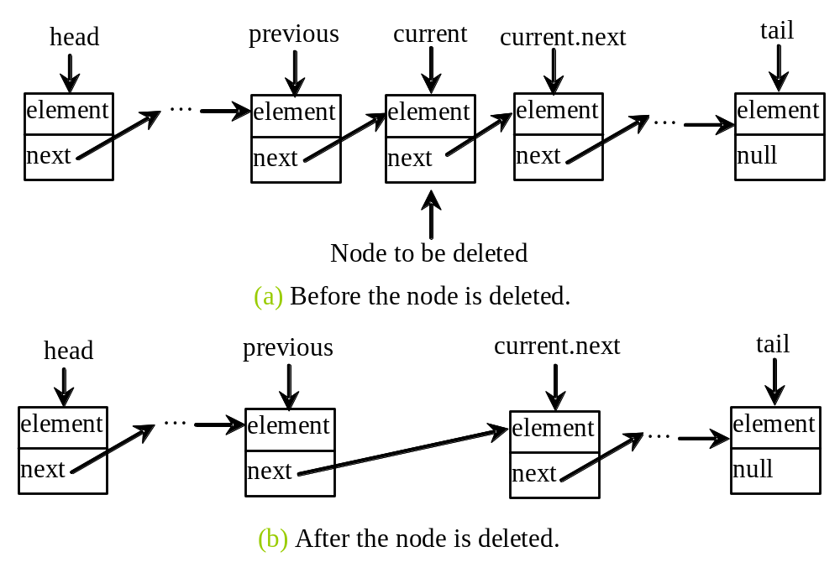
Implementing remove(int index)
public E remove(int index) {
if (index < 0 || index >= size) return null;
else if (index == 0) return removeFirst();
else if (index == size - 1) return removeLast();
else {
Node<E> previous = head;
for (int i = 1; i < index; i++) {
previous = previous.next;
}
Node<E> current = previous.next;
previous.next = current.next;
size--;
return current.element;
}
}

Slide 31
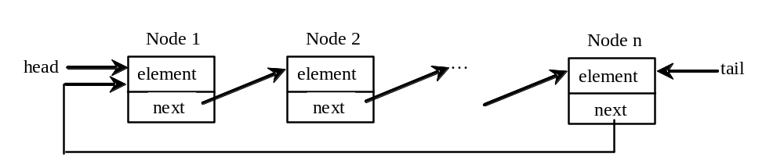
Circular Linked Lists
A circular, singly linked list is like a singly linked list, except that the pointer of the last node points back to the first node.

Slide 32
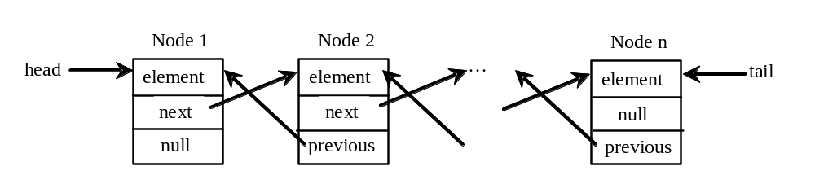
Doubly Linked Lists
A doubly linked list contains the nodes with two pointers. One points to the next node and the other points to the previous node. These two pointers are conveniently called a forward pointer and a backward pointer. So, a doubly linked list can be traversed forward and backward.

Slide 33
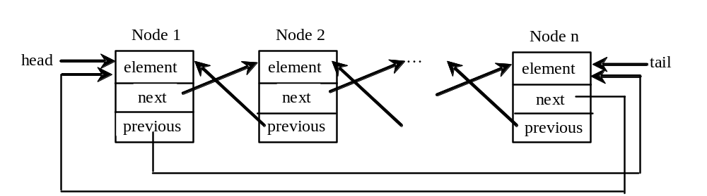
Circular Doubly Linked Lists
A circular, doubly linked list is doubly linked list, except that the forward pointer of the last node points to the first node and the backward pointer of the first pointer points to the last node.

Slide 34
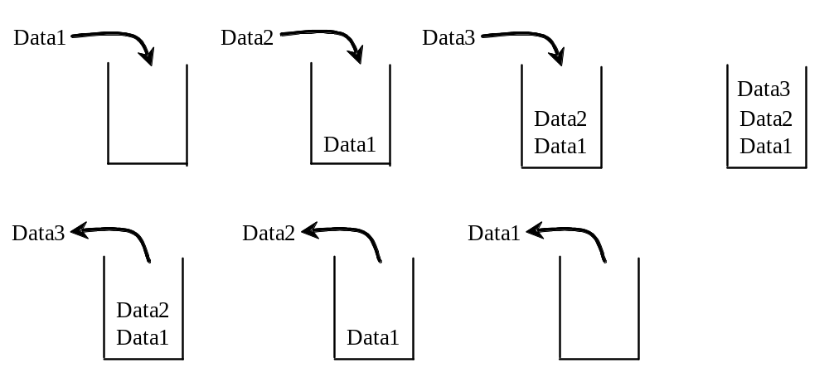
Stacks
A stack can be viewed as a special type of list, where the elements are accessed, inserted, and deleted only from the end, called the top, of the stack.

Slide 35
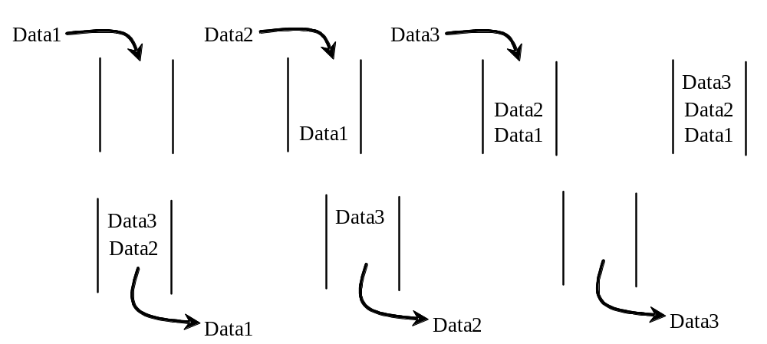
Queues
A queue represents a waiting list. A queue can be viewed as a special type of list, where the elements are inserted into the end (tail) of the queue, and are accessed and deleted from the beginning (head) of the queue.

Slide 36
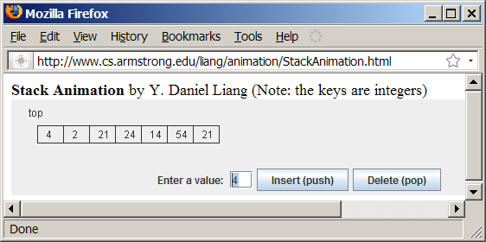
Stack Animation
www.cs.armstrong.edu/liang/animation/StackAnimation.html

Slide 37
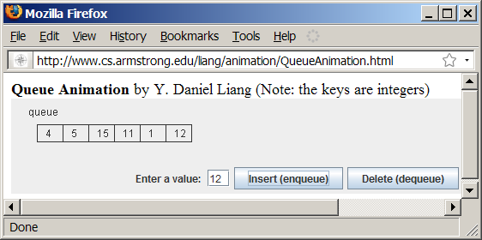
Queue Animation
www.cs.armstrong.edu/liang/animation/QueueAnimation.html

Slide 38
Implementing Stacks and Queues
Using an array list to implement Stack
Use a linked list to implement Queue
Since the insertion and deletion operations on a stack are made only at the end of the stack, using an array list to implement a stack is more efficient than a linked list. Since deletions are made at the beginning of the list, it is more efficient to implement a queue using a linked list than an array list. This section implements a stack class using an array list and a queue using a linked list.

Slide 39
Design of the Stack and Queue Classes
There are two ways to design the stack and queue classes:
  Using inheritance: You can declare the stack class by extending the array list class, and the queue class by extending the linked list class.
  Using composition: You can declare an array list as a data field in the stack class, and a linked list as a data field in the queue class.

Slide 40
Composition is Better
Both designs are fine, but using composition is better because it enables you to define a complete new stack class and queue class without inheriting the unnecessary and inappropriate methods from the array list and linked list.

Slide 41
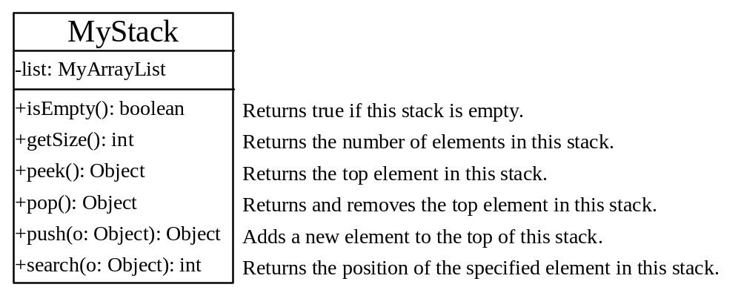
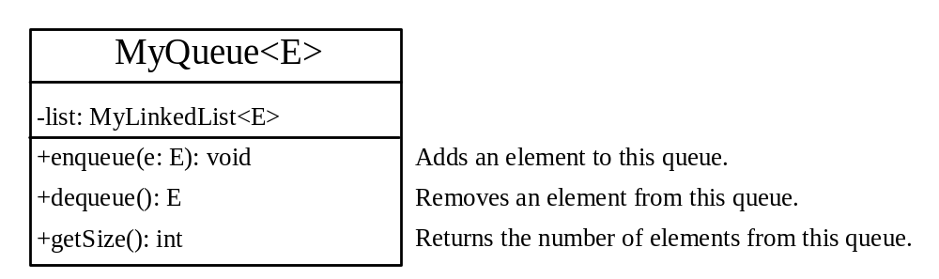
MyStack and MyQueue
MyStack
MyQueue

Slide 42
Example: Using Stacks and Queues
Write a program that creates a stack using MyStack and a queue using MyQueue. It then uses the push (enqueu) method to add strings to the stack (queue) and the pop (dequeue) method to remove strings from the stack (queue).
TestStackQueue
Run

Slide 43
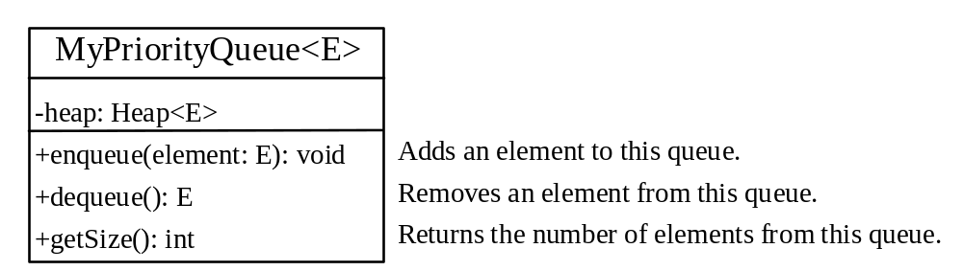
Priority Queue
A regular queue is a first-in and first-out data structure. Elements are appended to the end of the queue and are removed from the beginning of the queue. In a priority queue, elements are assigned with priorities. When accessing elements, the element with the highest priority is removed first. A priority queue has a largest-in, first-out behavior. For example, the emergency room in a hospital assigns patients with priority numbers; the patient with the highest priority is treated first.
MyPriorityQueue
TestPriorityQueue
Run

